Slide 1
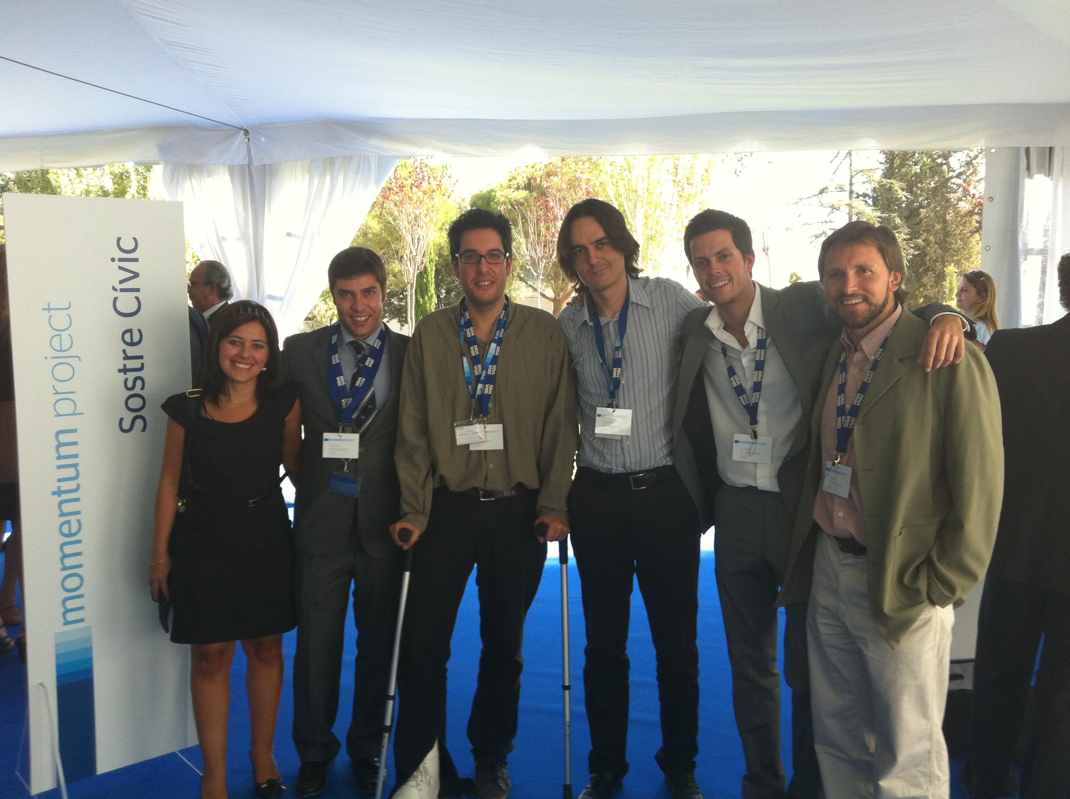
1.1 MOMENTUM PROJECT
The Momentum Project Spain is an accelerator program to support social entrepreneurs in their path to growth. It was co-founded in 2011 by a large bank and a business school, with the collaboration of one of the big four consultancy firms. The goal is to increase the social return and to help social enterprises become sustainable over the long term.
CONSOLIDATE
GROW
SCALE
ONE OF THE MOST UNIQUE, COMPREHENSIVE AND INNOVATIVE ACCELERATOR PROGRAMS FOR SOCIAL ENTERPRISES IN THE WORLD

Slide 2
Selection process
Financing YES
Financing NO
Training & Strategic mentoring
Visibility, Ecosystem & Networking
Access to Finance: Presentation to MSI SL
Elaboration of a Growth Business Plan
Who are Momentum candidates?
More than 100 applications each edition and only 10 are finally accepted to participate.
A team (>1 leader). Strong leadership
Significant and priority social impact.
Innovation
>. 2/3 years of operation
> 100.000€ revenue.
< 50% revenues from grants/donations.
High potential to scale + replicate.
Impact in Spain.
Why is that some Momentum social enterprises receive financing from MSI SL and others no?

Slide 3
Participating Enterprises of Momentum Project Spain
From 2011-2014, a total of 40 social enterprises have participated in the program.

Slide 5
1.2 MOMENTUM SOCIAL INVESTMENT FUND (MSI SL)
Evidence: Impact investment is growing exponentially
Over the last decade, philanthropic venture capital (‘impact investment’) has grown markedly in both The United States and in Europe.
In 2013 around US $11 billion of impact investment was invested worldwide in some 5,000 deals.
In 2014, it was estimated that the roughly $13 billion spent covered some 6,500 operations.
The sector is projected to growth to $ 500bn – 1tn by 2020
The MSI SL Investment Vehicle is the vehicle specifically created by the bank to invest in the form of capital (equity) or loan (debt) in the social enterprises that have gone through all the stages of Momentum Project and meet the conditions and criteria imposed by the fund’s managers for being a successfully social impact investment.
Notes:
FALTA TRADUCIR EL GRAFICO AL INGLES Y ADAPTARLO A LAS CARACTERISTICAS DE MSL

Slide 6
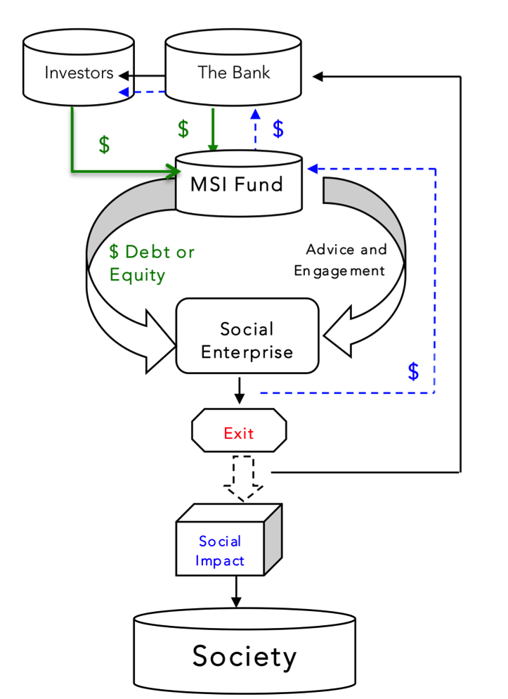

Slide 7
1.2.1 Key aspects of the loan: Investment instrument: loans with yield premiums and without warranties
1
2
3
4
5
6
7
8
Timeframe (years)
Principal repayment
Grace period - 4 years
25% anual
Interest rate
2%
4%
5%
6%
7%
8%
Objective: To capture the profitability of the proj. & share risks with them as if were shareholders.

Slide 8
1.2.2 Key aspects of the equity investment:
0%
10%
30%
In future
Premium in the case of company’s sale
Entrepreneur annual TIR
,
,
Without premium .
A premium % of the amount to be written off, depending on the time of sale
Premium equivalent to the entrepreneur’s profitability applied to the total investment, less 20%
Premium if extraordinary results are achieved
To be established according to the most appropriate parameters of each company
To be based on early repayment of the loans
Objective: To capture part of the value that might be produced from the sale of the company or through extraordinary results, as a consequence of our investment.

Slide 9
Our Aim:
We want to analyze how the tension generated between the seek for value or social impact and the financial return expected from an investment alongside with other factors effect the decision of the managers fund of whether or not to invest in a social enterprise. Can we explain why is that some Momentum Social Enterprises receive financing from MSI SL and others don’t?
2 Objectives to reach this goal:
Analyze the social enterprises participants of MP and classify them according to the continuum nonprofit and for-profit.
Study the main characteristics and functioning of the investment vehicle MSI SL and identify the main criteria followed to decide on which social enterprises to invest, from 2011 to 2014.
Methodology
This is an empirical study based on the experience of the four years of the first impact investment fund created in Spain (MSI SL). Data gathering was done through interviews and analysis of the growth plans.

Slide 10
Key references
VERNIS, A. and IGLESIAS, M. Empresas que inspiran futuro. Ocho casos de emprendedores sociales. ESADE, Instituto de Innovación Social, 2010.
SCARLATA, M. R. and ALEMANY, L. Deal structuring in philanthropic venture capital investments: financing instrument, valuation and covenants. Journal of Business Ethics, 95, 121-145, 2011.
ALEMANY,L. and SCARLATA, M.R. Philanthropic venture capital: a new model of financing for social entrepreneurs. Chapter 7 in D. Cumming (ed), Companion to Venture Capital. Wiley Press, 2009.
SANTOS, F. A positive Theory of Social Entrepreneurship. Journal of Business Ethics XX, 335-351, 2012.
DEES, G. A Tale of Two cultures, Problem Solving, and the Future of Social Entrepreneurship. Journal of Business Ethics xx, 321-334, 2012.
DEES, G and ANDERSON, B. Framing a Theory of Social Entrepreneurship: Building on Two Schools of Practice and Thought en Research on Social Entrepreneurship: Understanding and Contributing to an Emerging Field. ARNOVA Occasional Paper Series 1, (3), 2006.
BALBO, L., MORTELL, D. and OOSTLANDER, P. Establishing a venture philanthropy fund in Europe. EVPA Publications, Brussels, 2008.
VERNIS A., CASASNOVAS G. AND KOTELES B. Stories of Scale, nine cases of Growth in social enterprises. ESADE, Institute for Social Innovation, 2013.

Slide 11
3.1 CLASSIFICATION OF MOMENTUM S.E. INTO 4 GROUPS
Group | # | Legal form | Definition | Financed | Identified reasons
Group 1 | 12 | Association Foundation | Mainly non-for-profit entities with an entrepreneurial attitude. Search for new methods of obtaining revenues after the crisis. | #0. (0%) | Leaders not interested or/and Not seen as an interesting option by the MSI managers.
Group 2 | 9 | Association Foundation Cooperative | ‘Spin-off’. The social entrepreneurship project is managed independently. | #9 (10%) | Seen as potential opportunity for a successful and sustainable social impact investment.
Group 3 | 10 | S.A. S.L. Cooperative | Entities that clearly conform with the definition of Social Enterprise as an entrepreneurial approach to achieve social objectives. | #10 (100%) | The growth potential might be higher than in group 2.
Group 4 | 8 | S.A. S.L. | Entities with a low social motivation whose main goal is to obtain financing in order to scale their business. | #1 (12,5%) | Dubious and questionable social impact

Slide 12
3.2 WHERE IS EACH GROUP PLACED IN THE CONTINUUM?
NONPROFIT
Hybrid organizations
FOR-PROFIT
Social Impact only | Impact first but blended value | Financial value >>> Social value
Pure philanthropic NGOs and charities | Entrepreneurial NGO (provision of services) | Social Enterprise | Socially responsible business | Corporate Social Responsability | Mainstream market company
Grants and Donations | IMPACT INVESTMENT | Traditional mainstream investors
1
3
4
2

Slide 13
3.3 HOW HAS MSI SL BEHAVED FROM 2011-2014?
From 2011 to 2014, the MSI SL Investment Vehicle has financed 20 social enterprises, from a pool of 40 (exactly, 50%)
In ALL but ONE case the financing has been given through debt.
So far, any financed enterprise has defaulted in its payments (some delays)
Identified Investment Criteria for investee enterprises
Social Impact scalability
Expectations for economic and social growth
Reasonable growth business plans and investment needs
Investments focused on satisfying unfulfilled and latent demands to clients (preferable in productive assets)
High commitment from entrepreneurs
Good internal financial control
Financial Statements sustainable without non-recurring grants
Capacity to repay the loan and possibility to exit in equity investments.
Total investment in 4 years:
7 million €
Notes:
Sabem que son 7 millons d’euros aproximadament en 3 anys, qué podem afegir-hi de més aproximadament?

Slide 14
 | Mainly used when
DEBT | Enterprise’s corporate legal structure makes it difficult to enter in the equity Difficulties for divestment Fear of losing control or/and not wanting other partners be shareholders.
EQUITY | Enterprise’s legal structure permit it, i.e. it must be an SA or SL. The future sale of the shares is deemed possible. The entrepreneur let other shareholders own part of the capital.

Slide 15
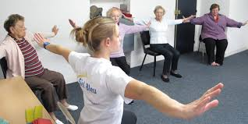
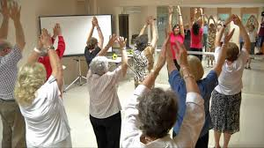
Example of Group 1
SIEL BLEU
http://sielbleu.es/
An Overview
Foundation: 2011. In Spain there were over 2 million people over 80 years. In 2050 this figure will be multiplied by three. The dignity of older people is being forgotten for a health system focused on curative or pharmacological solutions.
Focus: Health
The challenge: Reduce inactivity and loss of autonomy in elderly and dependent people offering solutions for aging well. Siel Bleu use physical activity as a method of prevention, support and improvement of quality of life.
Mission: Improve the quality of life of older adults, through fun and interactive, tailored exercise programs.

Slide 16
Invested? NO
Economic Impact | 2012 | 2013 | 2014
Total turnover (€) | 121.106 | 138.981 | 244.990
Profit (€) | 12.917 | 8.907€ | 4.688
Social Impact
# Employees (#labour insertion) | 9 (0) | 23 (0) | 34 (0)
# Beneficiaries | 1,050 | 2,010 | 3,495
Improving autonomy and mobility | - | 50% | 52%

Slide 17
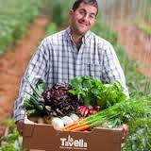
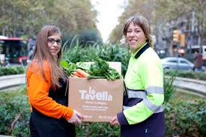
Example of Group 2
LA TAVELLA
www.latavella.cat/es
Origins: 2006, by the non-profit Association for the Social Integration of People with Deficiencies.
Focus: Organic agriculture and Labor inclusion.
The challenge: In Catalonia there are 44,200 working-age individuals with severe mental illness. The majority of them are unemployed.
Mission: Create meaningful jobs for individuals with SMI’s so their quality of life can radically improve, through the traditional agriculture values and the connection with nature.

Slide 18
Invested? Yes
Year of investment: 2013
Total invested by MSI SL: 90,726 € through debt
Economic Impact | 2012 | 2013 | 2014
Total turnover (€) | 66,022 | 279,970 | 480,000
Profit (€) | -21.321 | -63,377 | 75,000
Social Impact
# Employees (#labour insertion) | 13 (10) | 16 (13) | 17 (14)
# Beneficiaries | 10 | 13 | 13
Tn of ecologic products commercialized | 56 | 71 | 150

Slide 19
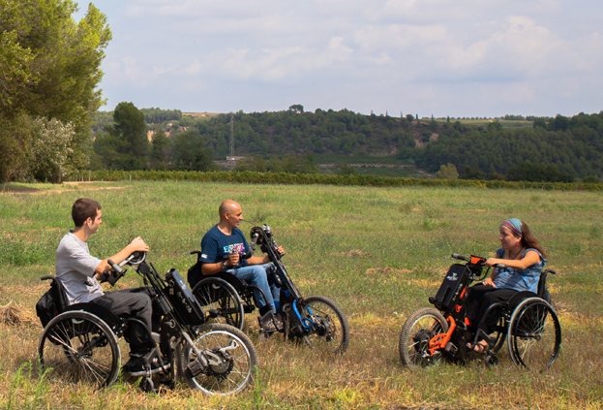
Example of Group 3
BATEC MOBILITY
www.batec-mobility.com
Origins: The origin is linked to the personal story of Pau Bach, the quadriplegic who founded the company in 2006 to bring the mobility solutions he was designing to other people with physical disabilities.
Focus: Dependent Assistance, healthy life, mobility.
The challenge: In Spain there are 1.2 million people with physical disabilities or reduced mobility. There are not innovative products that can help them improve their mobility. Batec takes up the challenge and designs, manufactures and sells attractive and high quality products (called Batec Handbikes).
Mission: Radically improve the mobility of disabled people with the aim to match their mobility with that of people without disabilities.

Slide 20
Invested? Yes
Year of investment: 2013
Total invested by MSI SL:
450.000 € (1st round) + 150.000 € (2nd round) in equity.
Economic Impact | 2012 | 2013 | 2014
Total turnover (€) | 605.305 | 1.009.544 | 1.801.691
Profit (€) | - 49.288 | -147.112 | 106.023
Social Impact
# Employees (#labour insertion) | 11 (7) | 20 (12) | 24 (11)
# Beneficiaries | 375 | 547 | 1041
% users that are not dependent on a third person any more | 64% | 74% | 75%

Slide 21
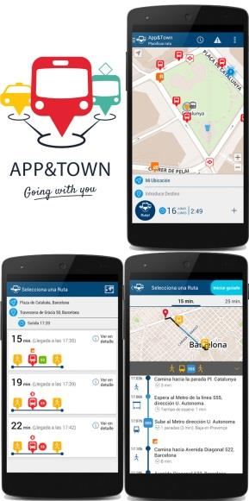
Example of Group 4
MASS FACTORY
http://www.appandtown.com/
An Overview
Origins: high-tech company, spin-off of the “Universitat Autònoma de Barcelona (UAB)”, established in October, 2012 following a final project of eight students led by PhD
Focus: High-tech
The challenge: People with cognitive, physical and sensory disabilities find it very difficult to move around big cities. Current mobile applications or other systems are not adapted to them and their autonomy is restricted.
Mission: Improve the degree of autonomy, well-being and quality of life of people with cognitive disabilities, and the people around them, through the development of the App&Town Compagnon, a system which allows to calculate Public Transport routes and guide and keep track of people with cognitive disabilities all throughout the trip

Slide 22
Invested? NO
Economic Impact | 2012 | 2013 | 2014
Total turnover (€) | 16,500 | 16,500 | 88,000
Profit (€) | 10,506 | -78,108 | -15,000
Social Impact
# Employees (#labour insertion) | - | 3 (1) | 4 (1)
# Beneficiaries | Not measured yet

