Slide 1
Professionalization and Social Change
Jennifer E Mosley, Ph.D.
University of Chicago
School of Social Service Administration

Slide 2
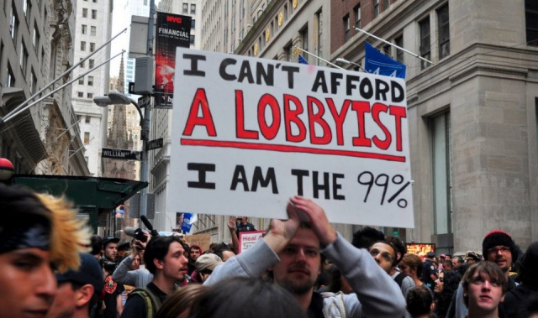
Professionalization and social change

Slide 3
Connection to nonprofit sector
Nonprofits are increasingly situated at the nexus of the professional and the grassroots
Many of dual identities: “we are professionally led AND we have grassroots support.”
Mobilize different images depending on need and context
Nonprofits often want to operate in a top-down way, while claiming bottom-up legitimacy.
Is it possible to be both?

Slide 4
Advocacy of Human Service Nonprofits
Professionalized
Large
Government funded
Insider orientation to advocacy
Looking to grow or maintain government funding (e.g. status quo), not lead fundamental social change

Slide 5
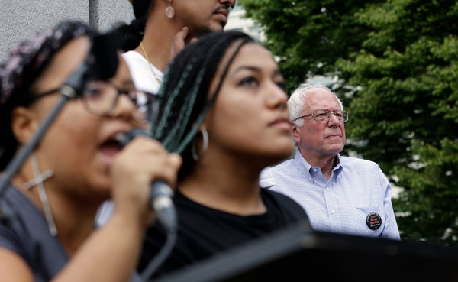
Distrust in professionals and “expert” knowledge

Slide 6
How important is the process of social change to the outcomes of social change?

