Slide 1
A Critical Analysis of Social Enterprise Education in the U.S. and Abroad
Angela Eikenberry, University of Nebraska at Omaha
&
Roseanne Mirabella, Seton Hall University

Slide 2
Purpose & Questions
Critically examine the implications of the growth of social entrepreneurship and social enterprise curriculum for nonprofit management education.
Questions:
What are the curricular models currently being used to educate future social entrepreneurs in and outside of the United States?
How does the U.S. compare to other countries?
To what degree do social enterprise programs currently reflect what the literature deems are important aspects of social enterprise values and outcomes? What curriculum should exist to enhance these values and outcomes?
Notes:
The purpose of this research is to critically examine the implications of the growth of social enterprise curriculum for nonprofit management education. We address the following questions: What are the curricular models currently being used to educate future social entrepreneurs in and outside of the U.S.? How does the U.S. compare to other countries? To what degree do social enterprise programs currently reflect what the literature deems are important aspects of social enterprise values and outcomes? What curriculum should exist to enhance these values and outcomes?

Slide 3
Methodology
A review of literature on nonprofit management education and social enterprise practices and impact
An analysis of program websites, concentration requirements, and course syllabi of nonprofit management and social enterprise-related courses.
Text from websites for 17 U.S. social enterprise programs and 40 international social entrepreneurship programs.
Concentration/Master requirements for 17 U.S. social entrepreneurship programs and 40 international social entrepreneurship programs.
Course descriptions and syllabi were analyzed using Atlas/ti, a qualitative software tool.
Notes:
Methods to gather data include an analysis of program descriptions, courses offered, and course syllabi of social entrepreneurship programs.

Slide 4
Why Important
Although it is growing in popularity, much of the attractiveness of social entrepreneurship is based on anecdotal evidence rather than systematic research.
As the millennial generation is now the primary ‘consumer’ of higher education, there will be increased demand for social entrepreneurship programming.
What we teach in professional degree programs will undoubtedly influence the world of practice, it is imperative that we critically examine the values inherent in this approach and its potential impact on third sector values of pluralism and democracy.
Notes:
Over the past several years, scholars have increasingly paid attention to the problematic effects of marketization on nonprofit, charitable and social benefit organizations. Regarding social enterprise, there are certainly examples of successful—in both the social and economic senses—social enterprises (Edwards, 2008, pp. 33-38; Alvord et. al, 2004), but they are few and far-between and tend to be more complex than they appear. Some scholars also suggest social enterprise can negatively affect the democratic contributions that nonprofit organization might make to civil society (Dey & Steyeart, 2010; Edwards, 2008; Eikenberry & Kluver, 2004; Eikenberry, 2009; Parkinson & Howorth, 2008), even as scholars and practitioners cite diversity and pluralism within the nonprofit and voluntary sector as one of its most valuable contributions to society and democracy (Drucker, 1992; Warren, 2001; Zimmerman & Dart, 1998).

Slide 5
Growth of Social Enterprise & SE Education
SE as an idea, discourse, and practice has gained prominence in the past decade or more.
SE has been linked to government downsizing and governance efforts in the US, UK and elsewhere.
Growing body of ‘how-to’ books, events, academic journals, and educational programs focused on social entrepreneurship and social enterprise practices.
In the US, almost two dozen social entrepreneurship programs, more than half in business schools.
Accompanying decline in the nonprofit courses offered by these programs
Nonetheless, social enterprise has grown in rhetoric and practice and social entrepreneurship and enterprise have become the current fashion in nonprofit management education programs
Notes:
Nonetheless, social enterprise has grown in rhetoric and practice and social entrepreneurship and enterprise have become the current fashion in nonprofit management education programs. In the late 1990s, there were only four social entrepreneurship courses offered in the United States, while today there are over 100 courses offered (http://academic.shu.edu/npo/).

Slide 6
Growth of SE Education: 1996 - Present
Notes:
According to Mirabella and Young (2012), in the United States, there are almost two dozen social entrepreneurship programs, from the certificate program jointly offered by SPEA and the Kelly Business School at Indiana University in Bloomington, to the full Master in Social Enterprise within the School of International Service at American University. Social entrepreneurship courses are offered in a variety of institutional settings, but the majority are in business school settings (Mirabella & Young, 2012). As Mirabella and Young show, these courses tend to focus on market, general management, and philanthropic skills and much less so on political and leadership skills. Although there is a vast literature on education for entrepreneurs, far less has been written on the special case of educating social entrepreneurs. We know little about the size and scope of social enterprise programs outside of the U.S. In fact, we know little more generally about the size and scope of nongovernmental or nonprofit studies programs outside of the U.S (Mirabella, et. al., 2015). The purpose of this research is to critically examine the implications of the growth of social enterprise curriculum for nonprofit management education. We address the following questions: What are the curricular models currently being used to educate future social entrepreneurs in and outside of the U.S.? How does the U.S. compare to other countries? To what degree do social enterprise programs currently reflect what the literature deems are important aspects of social enterprise values and outcomes? What curriculum should exist to enhance these values and outcomes?

Slide 7
Competing Discourses in Social Enterprise
Competing discourses within social entrepreneurship between those who practice it and those who set policy and fund it.
Practitioners: preoccupation with local issues, collective action, geographical community and local power struggles
Policy makers/funders: to promote efficiency, business discipline and financial independence.

Slide 8
Impact of Social Enterprise
We know little about the actual impact or efficacy beyond such claims (Peattie & Morley, 2008; Bertotti et al., 2012).
Provide goods & services
Develop skills
Create employment & experience
Using environmentally friendly practices
Develop new markets

Slide 9
Impact of Social Enterprise
Building social capital, infrastructure, and engagement.
Increase voluntary work, enhance the diffusion of knowledge and social norms within the community, diffuse trust and cooperation, and increase relationships and social cohesion (Borzaga, Depedri, Tortia, 2010, p. 46).
Help to build participation, social interaction, political engagement and bonding social capital and sometimes help individuals escape exclusion altogether (Teasdalel, 2010).
Builds ‘bonding’ and ‘bridging’ social capital whilst also addressing ‘downside’ social capital (Bertotti et al., 2010) .

Slide 10
Challenges of Social Enterprise
Employment generators but of relatively low-skilled & low-wage jobs; inconsistent practices; creaming (Blackburn & Ram, 2006; Peattie & Morley, 2008; Teasdale, 2012).
Tradeoff between social and economic purposes (Teasdale, 2010).
Can run counter to more positive social and economic outcomes (Dey & Steyaert, 2010).
Need to rejuvenate the “sociality” or relational ethic of social entrepreneurship (Bull et al., 2010; Dey & Steyaert, 2010; Hjorth, 2009; Humphries & Grant, 2005; Steyaert & Hjorth, 2006).
Notes:
One might also suggest hegemony of western values on southern nations.

Slide 11
Findings
Within the 17 programs in the U.S., there were 83 courses connected to the social entrepreneurship concentration, specialization or master’s degree.
Forty-four (37) are either a course in social enterprise or social entrepreneurship
Another eight courses focused on tools for social innovation (skills)
Most of the coursework in the programs we examined prepare students to undertake innovations and enterprises for social change.
Notes:
We examined the course offerings for 17 U.S. programs and 40 international social entrepreneurships programs. Within the 17 programs in the U.S., there were 83 courses connected to the social enterprise/entrepreneurship concentration, specialization, or master’s degree. Forty-four percent (37) are either a course in social enterprise or social entrepreneurship. Another eight courses focused on tools for social innovation (i.e., the skills needed to create social change or a social venture and an additional two courses on leading social change). If we include these two sets of courses with the courses specifically titled as either social entrepreneurship or social enterprise, more than half of the coursework (56%) in these programs fall within this category. In other words, most of the coursework in these programs provide direct instruction on preparing students to undertake innovations and enterprises for social change.

Slide 12
Figure 1: U.S. Social Entrepreneurship Program Descriptions: Key Terms
Notes:
a key word search of the ten syllabi of social entrepreneurship courses found no mention of citizens (with one exception—the use of the term ‘citizen sector’ coined by ASHOKA as a replacement term for the nonprofit sector), social capital, or democracy.

Slide 13
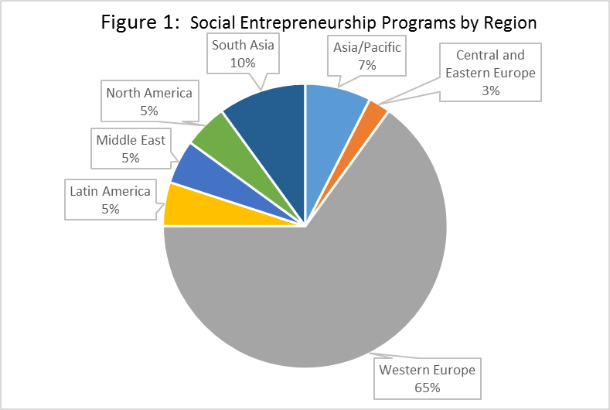
Notes:
Among the 40 international programs identified, the vast majority were found in Western Europe (Figure 2). Most social enterprise programs in Western Europe are in the UK. Not surprisingly, among the programs in South Asia, all are in India, in part reflecting the influence of the Grameen Bank and other micro-enterprise programs on curricular development.

Slide 14
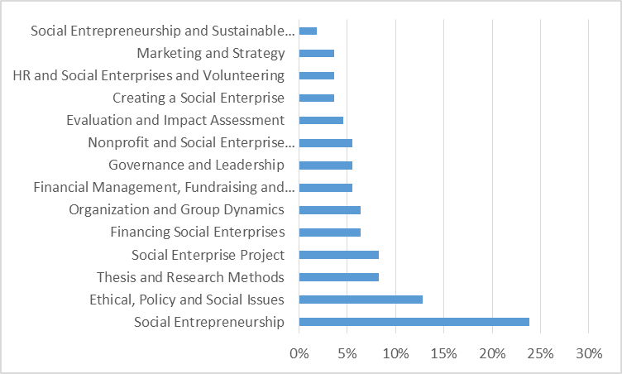
Figure 3: Required and Elective Courses in Social Entrepreneurship Programs
Notes:
In figure 3, the courses offered within these social entrepreneurship programs are displayed in order of frequency, with a course in social entrepreneurship comprising almost of the quarter of the courses within these programs. The next most frequent course is one examining ethical, policy and social issues. Included in this category are courses examining human rights, poverty, and humanitarian disasters.

Slide 15
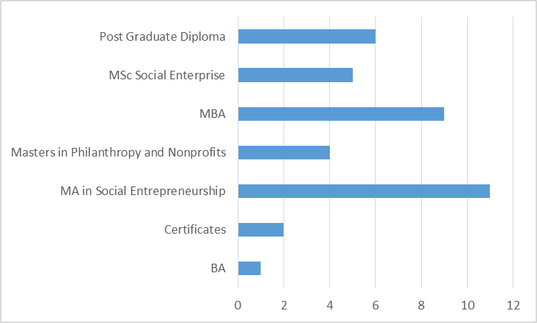
Figure 4: Degrees in Social Entrepreneurship
Notes:
The most frequently offered is an MA in Social Entrepreneurship (29%) followed closely by an MBA with a concentration in social entrepreneurship (23%). The MSc in Social Enterprise and the MA in Social Entrepreneurship comprise 42% of all degrees offered.

Slide 16
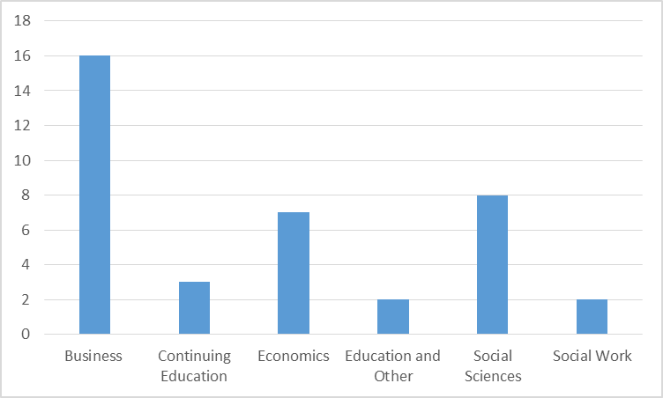
Figure 5: Location of Program within the Academy
Notes:
More than 4 in 10 of the programs are located within a Business School, with another 18% located in an Economics Department or a School of Ecnomics. About 21% of the programs analyzed are located in a social science department or school (Figure 5).

Slide 17
Table 1: Key Themes in Program Descriptions, Outside and in the U.S.
Themes | International | U.S.
Most Frequent | Innovation Change Sustainability Global Social/Financial Returns Policy Collaborative/Cooperative | Change Effectiveness Social Impact Innovation Global Apply Tools Private Sector Sustainability
Less Frequent | Social impact Effective Apply Tools Private Sector Multi-sectoral Ethics Diversity | Collaborative/Cooperative Policy Social/Financial Returns Ethics Diversity Root Causes
No or Little Mention | Root Causes Efficient Empower Democracy Social Capital Social Justice | Empower Social Justice Democracy Efficient Social Capital Empower
Notes:
Data were also gathered for program descriptions. In the 17 US programs, the descriptions were dominated by the key description areas of: “change” (97 mentions in 15 programs), “effective” (41 mentions in 15 programs), “social impact” (40 mentions in 8 programs), “innovation” (36 mentions in 11 programs), “global” (36 mentions in 11 programs), “application of tools from private sector/management” (23 mentions in 10 programs), and “sustainability” (19 mentions in 16 programs). Among the 19 programs outside of the U.S. examined, program descriptions are dominated by the key areas of: “innovation” (69 mentions in 9 programs), “change” (46 mentions in 11 programs), “sustainability” (33 mentions in 10 programs), “global” (33 mentions in 7 programs), “achieving social and financial returns” (22 mentions in 11 programs), “policy” (22 mentions in 8 programs), and “collaborative/cooperative” (21 mentions in 8 programs).
In the U.S. programs, less frequent areas mentioned were “collaborative” or “collaboration” (15 mentions in 8 programs), “policy” (15 mentions in 7 programs), “achieving social and financial returns” (13 mentions in 8 programs), “ethics” (14 mentions in 7 programs), “diversity” (14 mentions in 6 programs), and “root causes” (6 mentions in 4 programs). For programs outside of the U.S., less-frequently mentioned in program descriptions were areas such as: “social impact” (14 mentions in 9 programs), and “effective” (14 mentions in 6 programs), “application of tools from private sector/management” (8 mentions in 5 programs), “multi-sectoral” (5 mentions in 4 programs), “ethics” (5 mentions in 4 programs), “awareness or reflection” (5 mentions in 3 programs), and “diversity” (5 mentions in 3 programs).
There was very little or no mention in the U.S. programs of areas such as: “empower” (5 mentions in 3 programs), “social justice” (7 mentions in 4 programs), “democracy” (1 mention in 1 program), “efficient” (3 mentions in 3 programs), “social capital” (2 mentions in 2 programs), or “empower” (0). Areas rarely mentioned in programs outside the U.S. were: “root causes” (2 mentions in 2 programs), “efficient” (2 mentions in 2 programs), “empower” (2 mentions in 2 programs), “democracy” (2 mentions in 1 program), “social capital” (1 mention in 1 program), social justice (0).

Slide 18
Summary of U.S. and International
Prominent emphasis on innovation and change, sustainability, and global issues
Programs outside U.S. emphasized social/financial returns, policy, and collaborative/cooperative
U.S. programs emphasized effectiveness, social impact, and applying tools of the private sector
Both programs put some, but less emphasis on diversity and ethics
Little or no mention in U.S. or International programs of areas such as empower, democracy, social capital, and social justice.
Notes:
In sum, in both programs in and outside the U.S. there seems to be a prominent emphasis on innovation and change, sustainability, and global issues. In addition, programs outside the U.S. also emphasized social/financial returns, policy and collaborative/cooperative (there were less emphasized in the U.S.) while U.S. programs emphasized effectiveness, social impact, and applying tools of the private sector (less emphasized outside the U.S. Both programs also put some but less emphasis on ethics and diversity. International programs also mentioned multi-sectoral to some but a less degree while the U.S. program mentioned root causes to some but a less frequent degree. Both in and outside the U.S. no or little mention was made of areas such as empower, democracy, social capital, and social justice.

Slide 19
Conclusions
Social entrepreneurship and enterprise programs, located primarily within schools of business and economics departments, provide students with the tools needed to develop their own social enterprises.
Schools also have developed centers to support social enterprises in the communities, such as a Center for Social Innovation or a Social Innovation Center.
Funds are used to reward students developing the ‘best’ social enterprise models.
Notes:
The purpose of this research is to critically examine the growth of social entrepreneurship and social enterprise curriculum in colleges and universities globally. We did this through an analysis of program descriptions and course syllabi of social entrepreneurship and social enterprise-related courses and a review of literature on social enterprise and its impact. Our initial findings show that international social enterprise program, located primarily with schools of business and economics departments, provide students with the tools needed to develop their own social enterprises. We also found that many of universities have developed centers to support the development of social enterprises in communities, such as a Center for Social Innovation or a Social Innovation Center. These centers often provide funds that rewards students developing the ‘best’ social enterprise model.

Slide 20
Conclusions
Insufficient attention has been paid to areas such as social justice or democracy, nor do the programs (both U.S. and international) seem to examine the important role of community participation in the development of social enterprises.
Different from enterprises in the private sector, organizations within the third sector must be responsive to the citizens they serve.
Students should be rewarded not for the development of the “best’ model, but rather for successfully engaging with community members in the development and implementation of programs that best meet community identified needs.
Notes:
Although some of the international programs covered ethical and societal issues more frequently and more extensively than curricular offerings in the U.S., similar to our U.S. findings, the international courses we examined mentioned very little areas such as social justice or democracy, nor did they seem to examine the important role of community participation in the development of social enterprises. Business schools have historically offered entrepreneurship as a tools based curriculum providing opportunities for students to start their own business and using contests to reward successful outcomes. When developing social enterprise programs, we would argue that sufficient attention needs to be paid to the role of the nonprofit or NGO in social capital building. Different from enterprises in the private sector, organizations within the third sector must be responsive to the citizens they serve. Students should be rewarded not for the development of the ‘best’ social enterprise model, but rather for successfully engaging with community members in the development and implementation of programs that best meet community identified needs.

