Slide 1
Different schools of Social Enterprises

Slide 2
Agreed Definition
A social enterprise is an organization that applies commercial strategies to maximize improvements in human and environmental well-being - this may include maximizing social impact rather than profits for external shareholders. Social enterprises can be structured as a for-profit or non-profit, and may take the form (depending in which country the entity exists and the legal forms available) of a co-operative, mutual organization, a disregarded entity, a social business, a benefit corporation, a community interest company (L3C), or a charity organization.

Slide 3
USA – Framing a Theory Of Social Entrepreneurship: Building on two schools of practice and thought:

Slide 4
USA

Slide 5
USA

Slide 6
USA - Social Entrepreneurship and Broader Theories: Shedding New Light on the ‘Bigger Picture’

Slide 7
USA

Slide 8
usa
Business Models of Social Enterprise: A Design Approach to Hybridity* PROF Wolfgang Grassl

Slide 9
USA

Slide 10
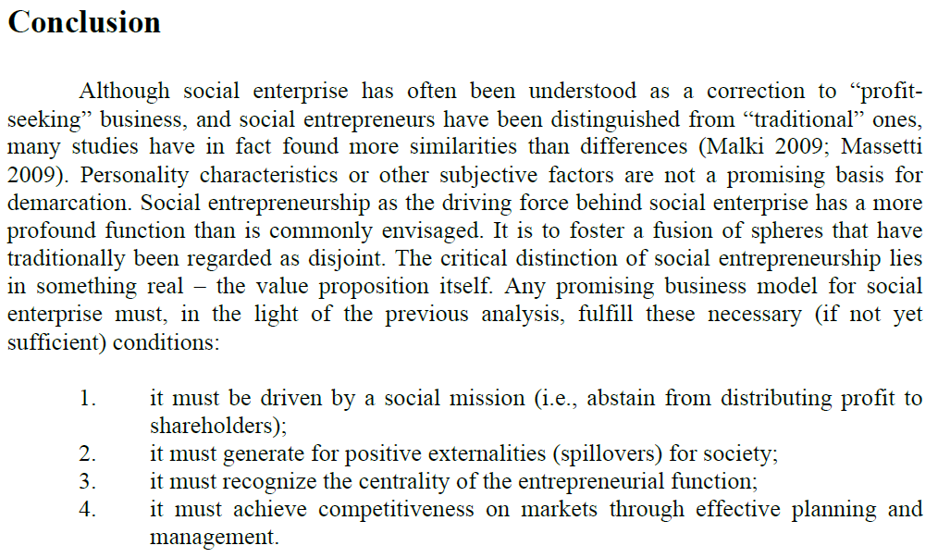
USA

Slide 11
South Korea Social Enterprise Promotion Act

Slide 12
Finland Social Enterprise Legislation

Slide 13
Slovenia – Social Entrepreneurship Act

Slide 14
Slovenia – Social Entrepreneurship Act

Slide 15
Slovenia – Social Entrepreneurship Act

Slide 16
Spain Social Economy Legislation

Slide 17
Sweden - The Practice of Social Entrepreneurship: Theory and the Swedish Experience

Slide 18
Study on Practices and Policies in the Social Enterprise Sector in Europe

Slide 19
Study on Practices and Policies in the Social Enterprise Sector in Europe

Slide 20
Study on Practices and Policies in the Social Enterprise Sector in Europe

Slide 21
Study on Practices and Policies in the Social Enterprise Sector in Europe

Slide 22
UK – key fact on social entrepreneurship

